Slide 1
Data Manipulation - Part 1
Jeremy Bergmann - Omaha Data Science Academy

Slide 2
Review: Class 2 - Writing Queries
What are the common SQL clauses?
What are the common aggregations/functions?
How to you utilize comments for debugging or explaining code?
What are the various SQL function types?
What is a subquery, and what is its purpose?
Notes:
SELECT column
FROM table_name
WHERE conditions
GROUP BY column
ORDER BY column
Write a summary of the information as if explaining to a 14 year old. Avoid jargon Keep the words and sentences simple Rely on memory Make the explanation visual, if possible Note where you had difficulty or have knowledge gaps. These indicate things you should review, research, or ask questions about

Slide 3
Class 3 Objectives
Part 1 - Data Storage
Create and delete databases
Create and delete tables
Create tables with constraints
Add and delete table fields
Add and delete table constraints
Insert data manually into tables
Import data from SQL and CSV files
Part 2 - Data Manipulation
Create and delete views
SQL Operators, Wildcards, Like, etc.
Case Statements & Logical Functions
Clean string, numeric, and date data
Perform joins - inner, outer and left
Notes:
Feynman technique: Learn -> Explain -> Reflect -> Repeat
What are the most important ideas from last class? Write a summary of the information as if explaining to a 14 year old. Avoid jargon Keep the words and sentences simple Rely on memory Make the explanation visual, if possible Note where you had difficulty or have knowledge gaps. These indicate things you should review, research, or ask questions about

Slide 4
What is the need for data manipulation?
Creating new datasets & Combine disparate data sets
Perform common queries, aggregations, and joins
Adding, removing, or modifying data
Extracting and Storing Data
Creation/Extraction
Transformation data
Cleaning data
Storage & Retrieval
Notes:
Creation: creating tables and databases, the things
Storage: where data are stored
Cleaning: adding, removing, or modifying data
Retrieval: selecting only the data you want

Slide 5
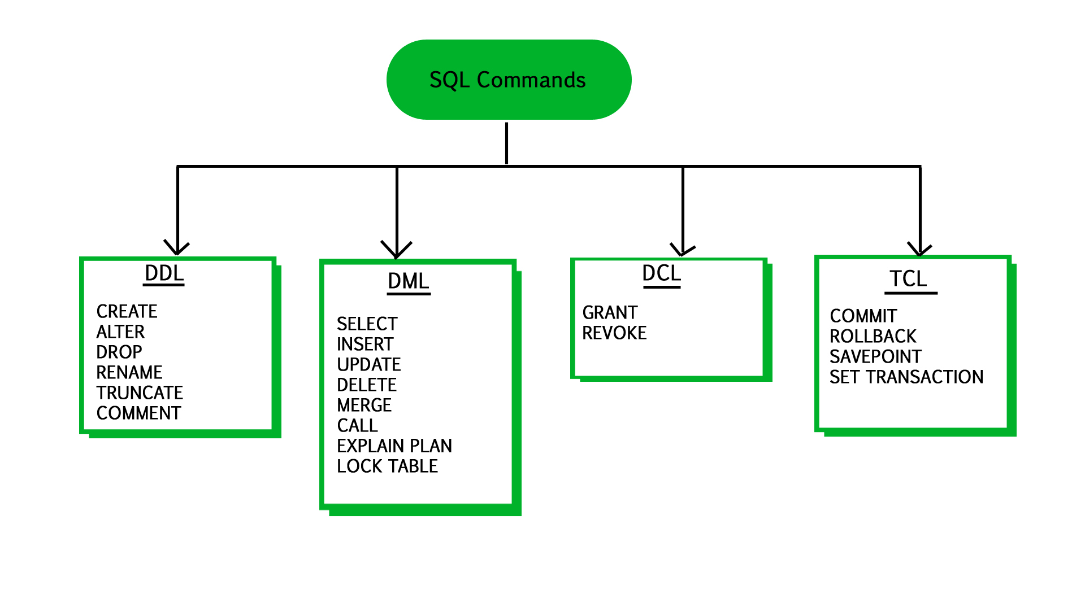
Modify data in tables
User Access
modifying data structures
Version Control
manipulating data
Notes:
Data Definition Language (DDL): Statements for defining and modifying data structures Ex: DROP, ALTER, RENAME, TRUNCATE
Data Manipulation Language (DML): Statements for manipulating data in tables Ex: SELECT, INSERT, UPDATE, DELETE
Data Control Language (DCL): Statements for managing users’ rights Ex: GRANT, REVOKE
Transaction Control Language (TCL);Statements for saving changes; a limited kind of version control Ex: COMMIT, ROLLBACK

Slide 6
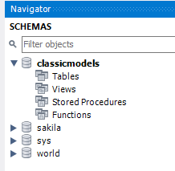
Create a New Database/Schema
Purpose - Creating a container for persistent Data Storage & Retrieval.
Database Description
The classicmodels database is a retailer of scale models of classic cars database. It contains typical business data such as customers, products, sales orders, sales order line items, etc.
Code
CREATE DATABASE classicmodels;
USE classicmodels;
Source: http://www.mysqltutorial.org/mysql-sample-database.aspx

Slide 7
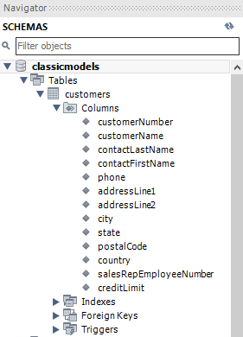
Creating Tables
Purpose - Creating a tabular structure for persistent Data Storage & Retrieval.
use classicmodels;
CREATE TABLE `customers` ( `customerNumber` int(11) NOT NULL, `customerName` varchar(50) NOT NULL, `contactLastName` varchar(50) NOT NULL, `contactFirstName` varchar(50) NOT NULL, `phone` varchar(50) NOT NULL, `addressLine1` varchar(50) NOT NULL, `addressLine2` varchar(50) DEFAULT NULL, `city` varchar(50) NOT NULL, `state` varchar(50) DEFAULT NULL, `postalCode` varchar(15) DEFAULT NULL, `country` varchar(50) NOT NULL, `salesRepEmployeeNumber` int(11) DEFAULT NULL, `creditLimit` decimal(10,2) DEFAULT NULL, PRIMARY KEY (`customerNumber`), KEY `salesRepEmployeeNumber` (`salesRepEmployeeNumber`), CONSTRAINT `customers_ibfk_1` FOREIGN KEY (`salesRepEmployeeNumber`) REFERENCES `employees` (`employeeNumber`));
Table & Field Names
Constraints
Table Keys - Primary & Foreign

Slide 8
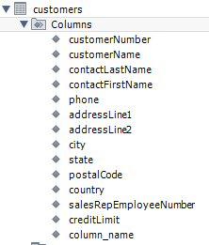
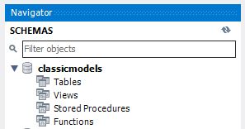
Modifying & Deleting Tables
Purpose - Change (Modify) or Delete (Drop) a tabular structure from the database
Add Column - ALTER TABLE customers ADD column_name varchar(255);
Drop Column - ALTER TABLE customers Drop column_name;
Drop Constraint - DROP constraint `customers_ibfk_1`;
Delete - DROP TABLE IF EXISTS `customers`;

Slide 9
Manually Insert Values into Table
Purpose - Store persistent values that allow for the Creation/Extraction of data
insert into classicmodels.customers (`customerNumber`,`customerName`,`contactLastName`,`contactFirstName`,`phone`,`addressLine1`,`addressLine2`,`city`,`state`,`postalCode`,`country`,`salesRepEmployeeNumber`,`creditLimit`) values
(103,'Atelier graphique','Schmitt','Carine ','40.32.2555','54, rue Royale',NULL,'Nantes',NULL,'44000','France',1370,'21000.00'),
(112,'Signal Gift Stores','King','Jean','7025551838','8489 Strong St.',NULL,'Las Vegas','NV','83030','USA',1166,'71800.00')
Result: Select * from customers
customerNumber | customerName | contactLastName | contactFirstName | phone | addressLine1 | addressLine2 | city | state | postalCode | country | salesRepEmployeeNumber | creditLimit
103 | Atelier graphique | Schmitt | Carine | 40.32.2555 | 54, rue Royale | NULL | Nantes | NULL | 44000 | France | 1370 | 21000
112 | Signal Gift Stores | King | Jean | 7025551838 | 8489 Strong St. | NULL | Las Vegas | NV | 83030 | USA | 1166 | 71800

Slide 10
Update Existing Values in Table
Purpose - Store persistent values that allow for the Creation/Extraction of data
update classicmodels.customers
SET city = 'Omaha'
where customerNumber = 103;
Result: Changes the top (Old) record value to bottom (New) values specified in “SET” keyword
customerNumber | customerName | contactLastName | contactFirstName | phone | addressLine1 | addressLine2 | city | state | postalCode | country | salesRepEmployeeNumber | creditLimit
103 | Atelier graphique | Schmitt | Carine | 40.32.2555 | 54, rue Royale | NULL | Nantes | NULL | 44000 | France | 1370 | 21000
103 | Atelier graphique | Schmitt | Carine | 40.32.2555 | 54, rue Royale | NULL | Omaha | NULL | 44000 | France | 1370 | 21000

Slide 11
Delete Records in Table
Purpose - Remove/Delete existing records in a table.
Example: Delete from classicmodels.customers WHERE customerNumber = 112;
Result: Select * from customers (Excludes RED record)
customerNumber | customerName | contactLastName | contactFirstName | phone | addressLine1 | addressLine2 | city | state | postalCode | country | salesRepEmployeeNumber | creditLimit
103 | Atelier graphique | Schmitt | Carine | 40.32.2555 | 54, rue Royale | NULL | Omaha | NULL | 44000 | France | 1370 | 21000
112 | Signal Gift Stores | King | Jean | 7025551838 | 8489 Strong St. | NULL | Las Vegas | NV | 83030 | USA | 1166 | 71800

Slide 12
What is a View?
Purpose - A view is a “virtual table” based on the result-set of an SQL statement, saved as a database object for future data creation/extraction.
SQL Views have the following properties:
A view is a named derived table.
CREATE/ALTER/DROP VIEW clauses
Views are not stored and its query must be run every time it is needed.
Used to call up data without changing its underlying base tables.
Example
CREATE VIEW world.vw_countries_asia AS
SELECT tbl.Name AS 'Country'
FROM world.country as tbl
WHERE (tbl.Continent = 'Asia')
View Usage
SELECT country
FROM world.vw_countries_asia
WHERE Country in ('India', 'China', 'Nepal')
Notes:
A derived table is the result of a query that looks like a table.

Slide 13
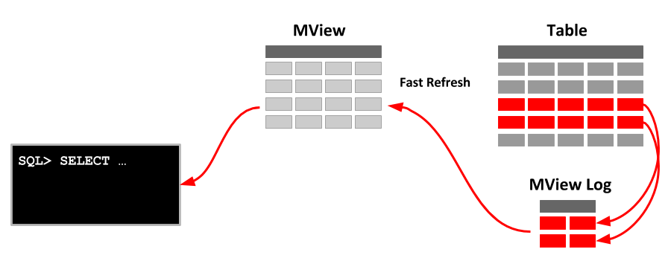
Materialized View
A view that is stored as a database object, containing the results of a query. The view’s calculations are stored as well, so it has increased performance speed. It can be refreshed as the tables it draws from are updated at various intervals. Used to call up or perform calculations on data without changing the underlying base tables.

Slide 14

Exercises
Data Storage & Manipultaion
1. Create a schema named “MissingPersons”
2. Create a table in “MissingPersons” schema named “person”, with the following qualities:
Fields: ID, LastName, FirstName, Age
Primary Key: ID
Field Constraints: Not Nullable
3. Alter the table to include (add) a “Gender” field.
4. Insert the following records into the table:
(1,'Doe','Jane',42,F') ,(2,'Doe','John',57,M'),
(3,'Presley','Elvis',82,M') ,(4,'Shakur','Tupac',49,M')
5. Delete the record with “LastName” = “Presley”
6. Update the LastName in the record that contains “ID” = 4 to “LastName” = ‘Crooks’
7. delete the column “First Name” from the table
8. drop the “person” table from the “MissingPersons” schema.

Slide 15

Class Project
Data Storage & Manipultaion
1. The business is in need of storing additional video game sales data, to understand the current “top games” in the marketplace.
Create a table named “console_game_sales” in the consoles schema, using the “ConsoleGames_201905.csv” file in the “Class Project/consoles” folder
Create a SQL script that inserts the values of the CSV file, into the “console_game_sales” table.
2. The company is not interested in producing Sports Games - Remove these observations from the “console_game_sales” table
3. The CEO insist that “Barbie Adventure Game” is a top-seller. Insert a record with that “Title” into the table, for comparison purposes (mock-up field values)

